Slide 1
GPU
Jianyue Wu
16/06/2024

Slide 2
Agenda
Nvidia CUDA
OpenCL
OpenGL
Performance tuning

Slide 3
Nvidia CUDA

Slide 4
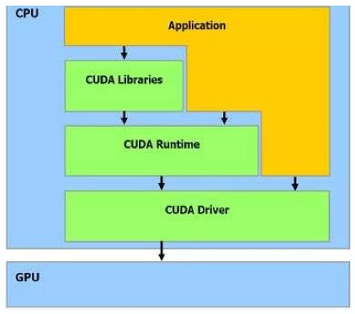
CUDA overview

Slide 5
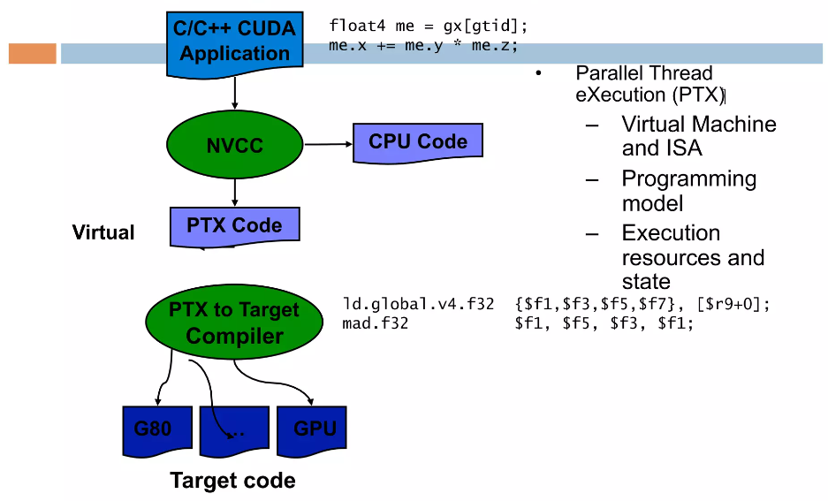
Compiling a CUDA program

Slide 6
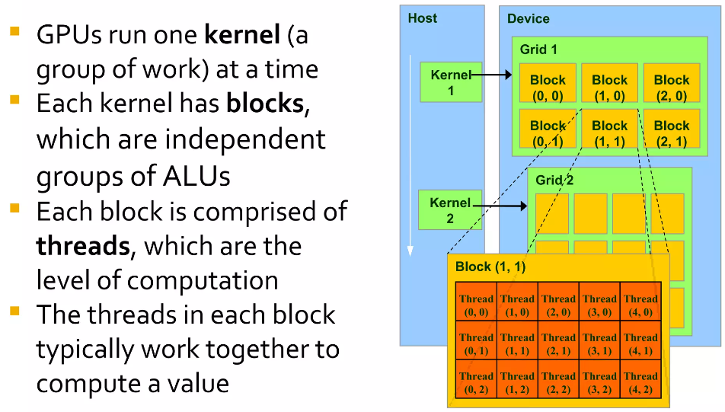
How CUDA works

Slide 7
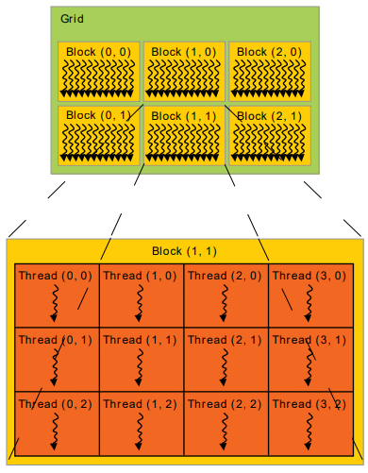
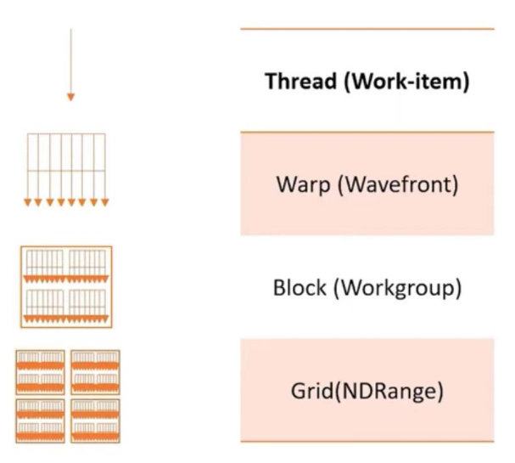
Thread hierarchy

Slide 8
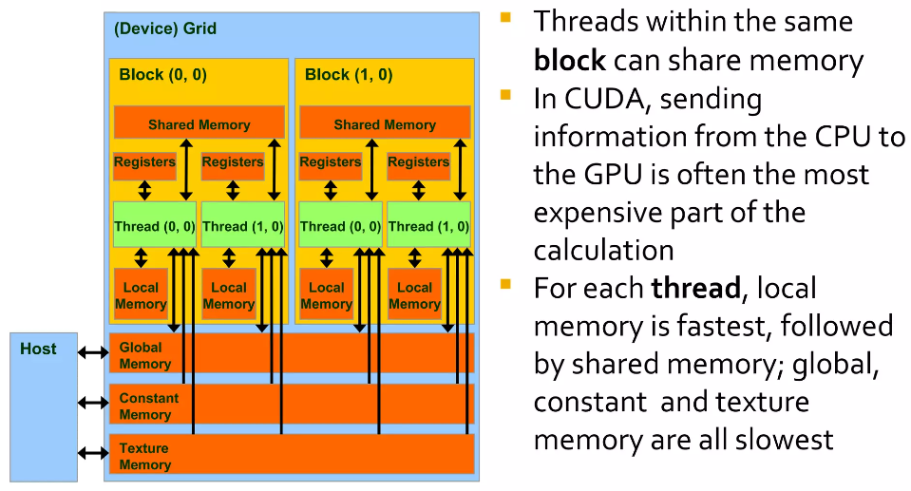
Memory hierarchy
Constant Memory is a read-only cache on GPUs optimized for situations where all threads access the same unchanging data,
reducing latency and bandwidth usage. Write by host, read by GPU, 64kB constants.
Texture Memory provides efficient, spatially localized read access and is suited for tasks like image processing, that benefit from
hardware-accelerated interpolation and boundary checking.
GPUs support multiple physical page sizes but prefer 2MiB physical pages or larger.

Slide 9
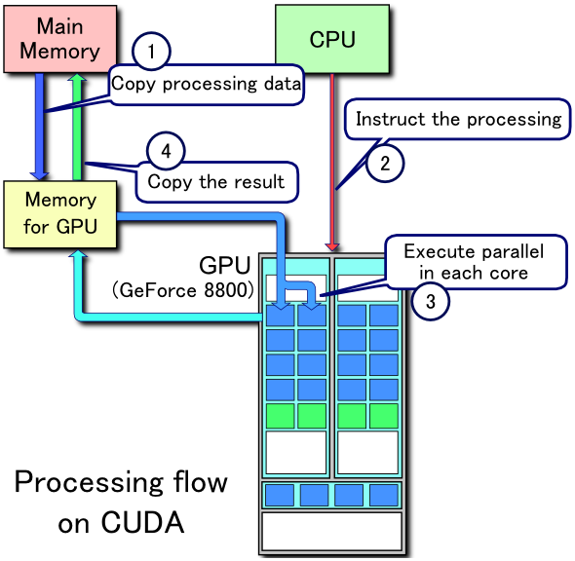
CUDA processing flow

Slide 10
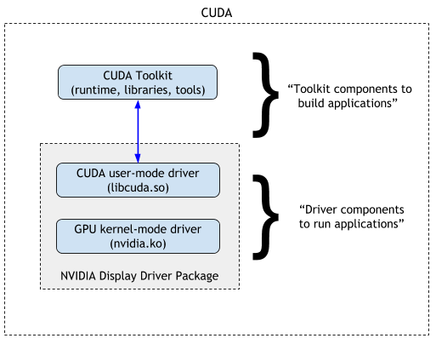
CUDA driver

Slide 11
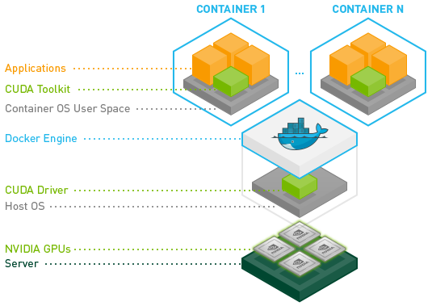
CUDA container
CUDA (Compute Unified Device Architecture) is provided by Nvidia.

Slide 12
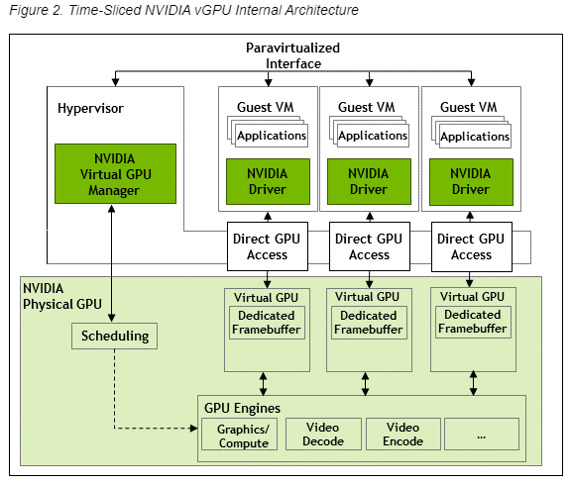
vGPU

Slide 13
AMD ROCm

Slide 14
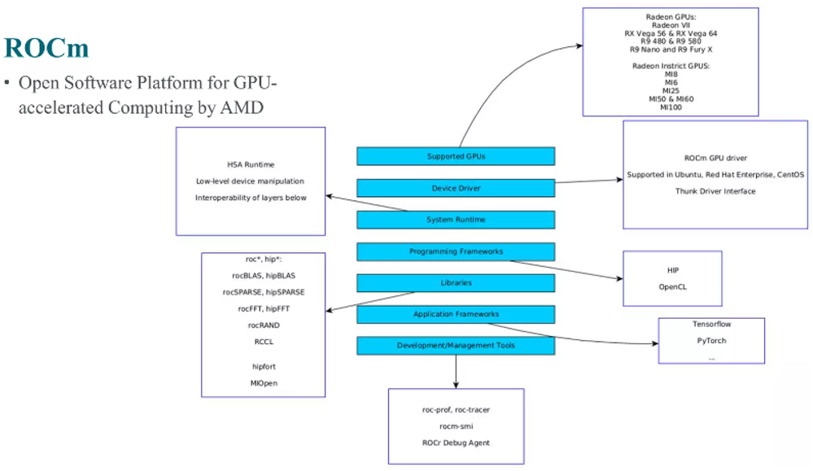
ROCm (Radeon Open Compute)

Slide 15
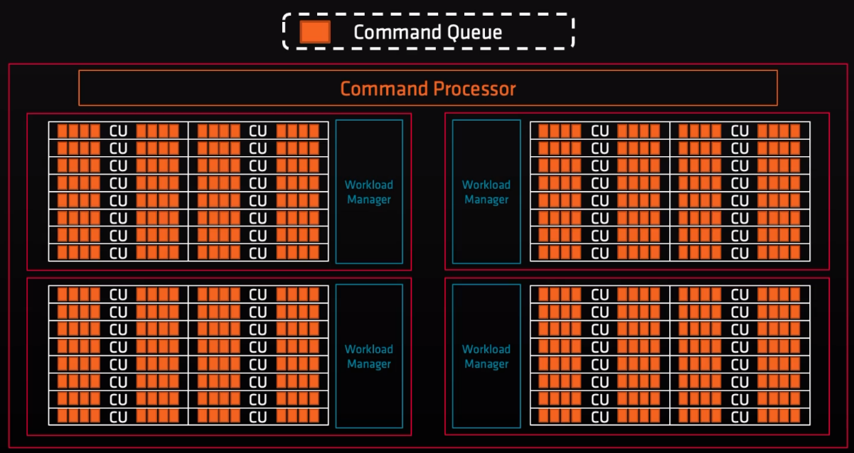
GPU scheduling

Slide 16
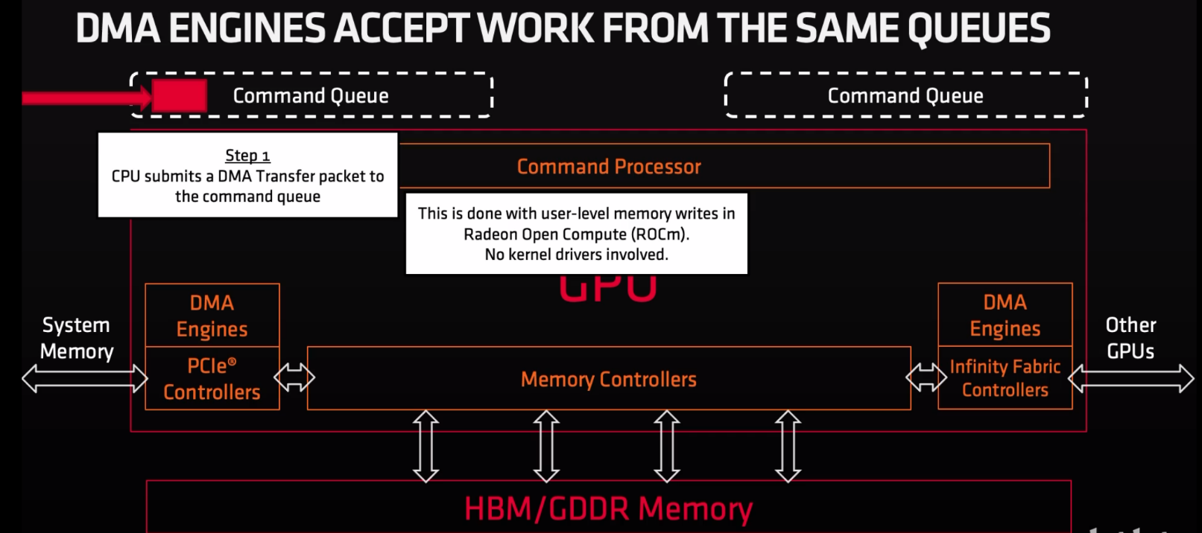
GPU scheduling

Slide 17
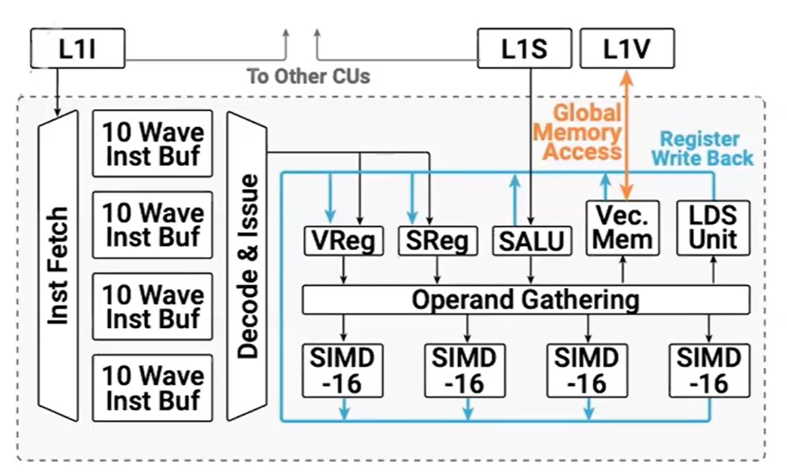
AMD CU

Slide 18
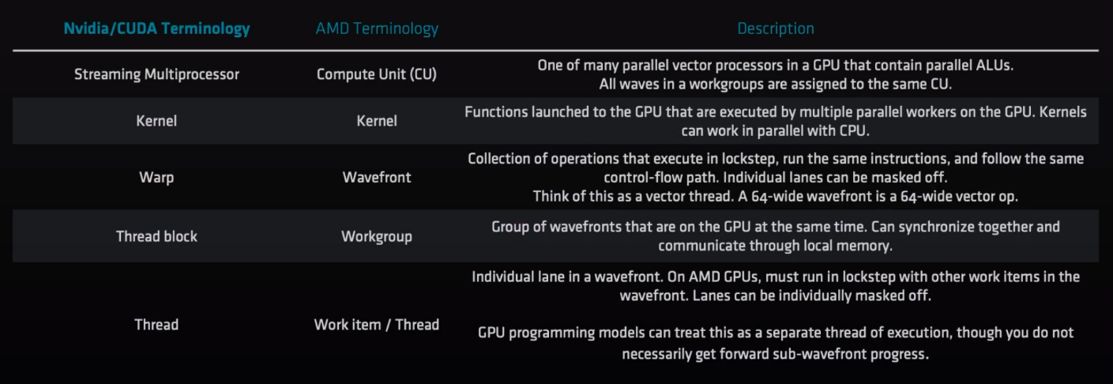
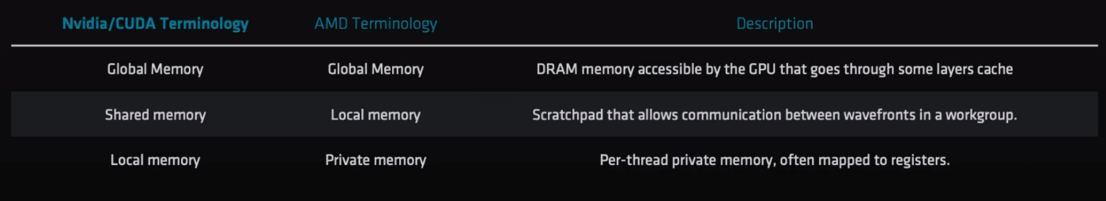
Terminology

Slide 19
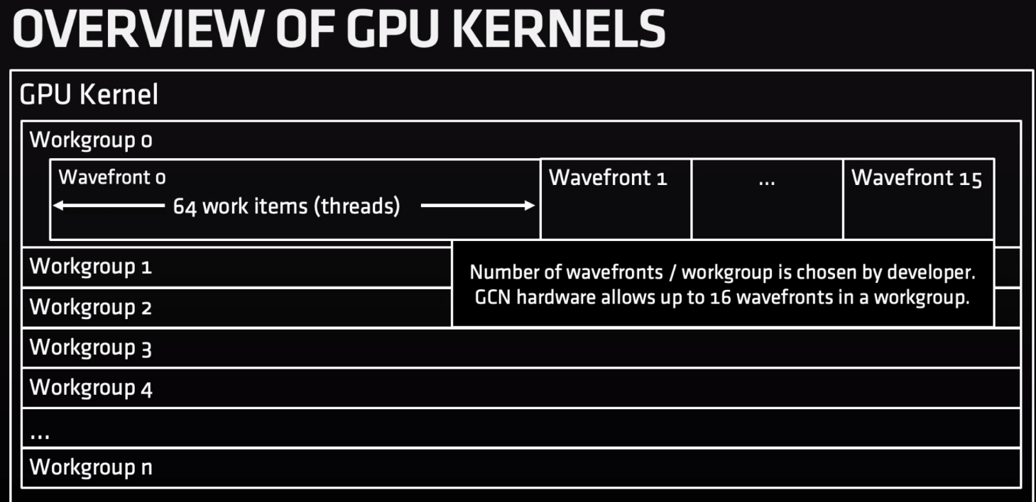
AMD GPUs

Slide 20
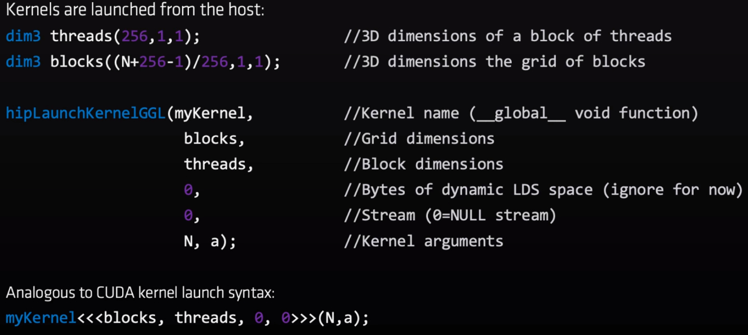
Sample code

Slide 21
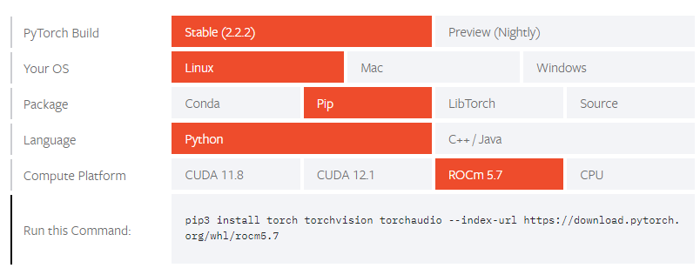
Install PyTorch with ROCm
For AMD ROCm, currently it is only supported in linux.
Start Locally | PyTorch

Slide 22
OpenCL

Slide 23
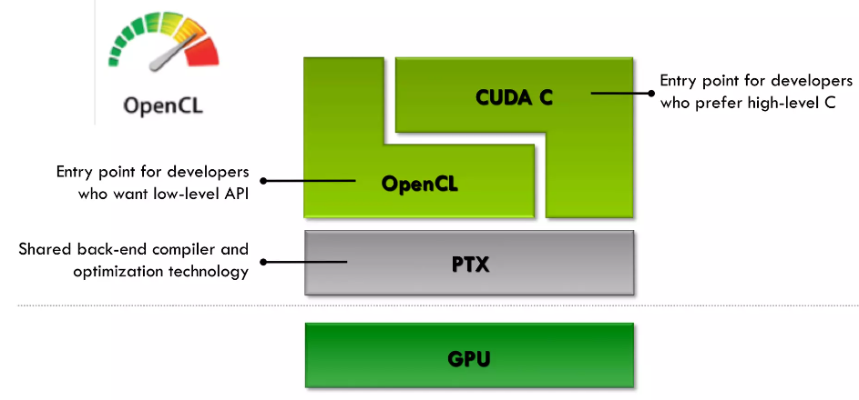
OpenCL overview

Slide 24
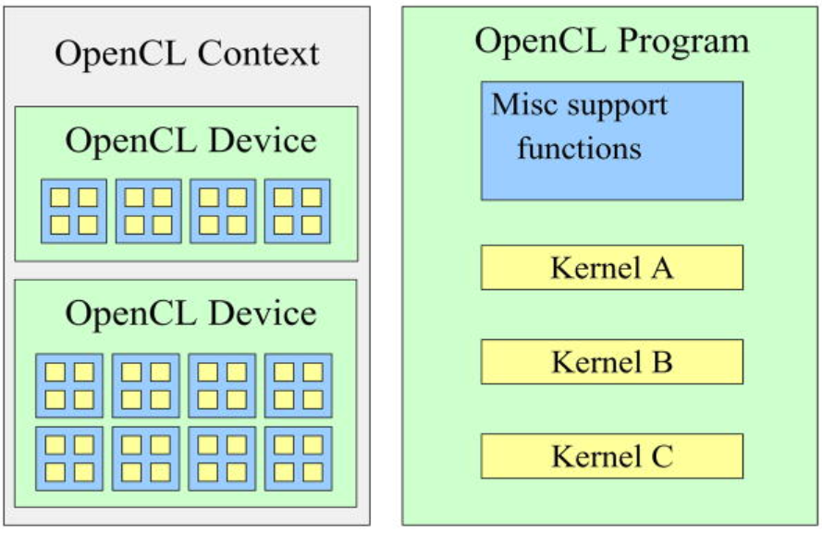
OpenCL overview
Device can be GPU, CPU, or DSP.

Slide 25
OpenGL

Slide 26
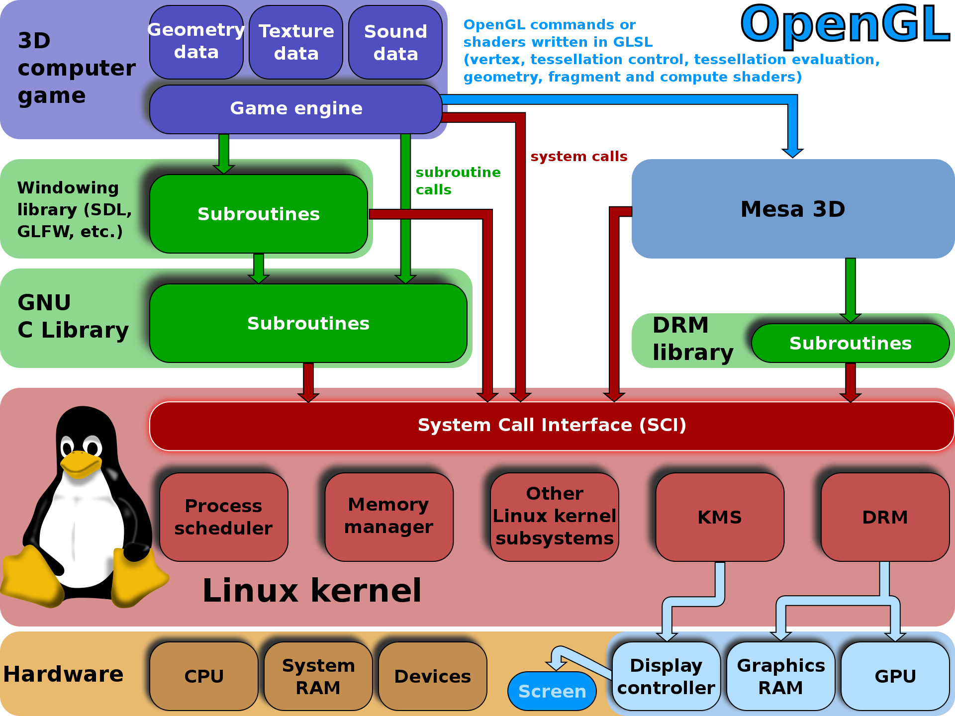
OpenGL (Open Graphics Library)
GLSL (OpenGL Shared Library) is based on C.

Slide 27
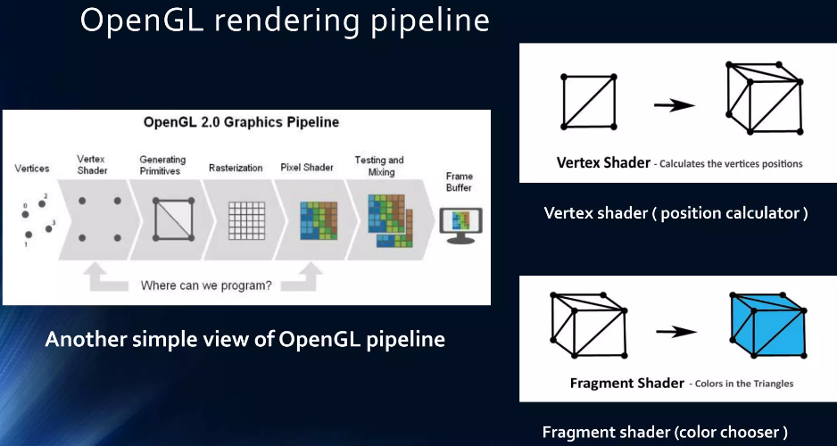
OpenGL – Rendering pipeline
VAO (Vertex Array Objects) defines what data it has, includes position, color, texture, etc.
VBO (Vertex Buffer Objects) defines data itself.
Simplest OpenGL usually has vertex shader and fragment shader.
Depth test: front or behind.

Slide 28
Performance tuning

Slide 29
ROCm/CUDA performance optimization
Reduce Kernel Overhead
Increase amount of work per kernel call
Decrease total number of kernel calls.
Amortize overhead of each kernel call across more computation.
Launch kernels back-to-back (each call of kernel cost 3-9 us, 1000 times of calling a common C function)
Kernel calls are asynchronous: avoid explicit or implicit synchronization between kernel calls.
Overlap kernel execution on the GPU with driver access on the CPU.
Reduce Memory Management Overhead
Reduce the number of memory allocations
Allocate memory once and reuse it throughout the application.
If the memory size is unknown beforehand, estimate and allocate it initially, and only perform minimal re-allocations as needed.
Reduce Memory Transfer Overhead
If the CPU operates on values produced by the GPU:
Move the operation to the GPU.
May improve performance even if the operation itself is slower on the GPU.
Avoid Global Memory Fences
Confine dependent computations to a single thread block
Execute an iterative algorithm until convergence in a single kernel call.
Only efficient if there are multiple independent computations.

